Slide 1
Network Layer

Slide 2
This layer is concerned with getting packets from the source all the way to the destination.
Getting to the destination may require making many hops at intermediate routers along the way.
Thus, the network layer is the lowest layer that deals with end-to-end transmission.

Slide 3
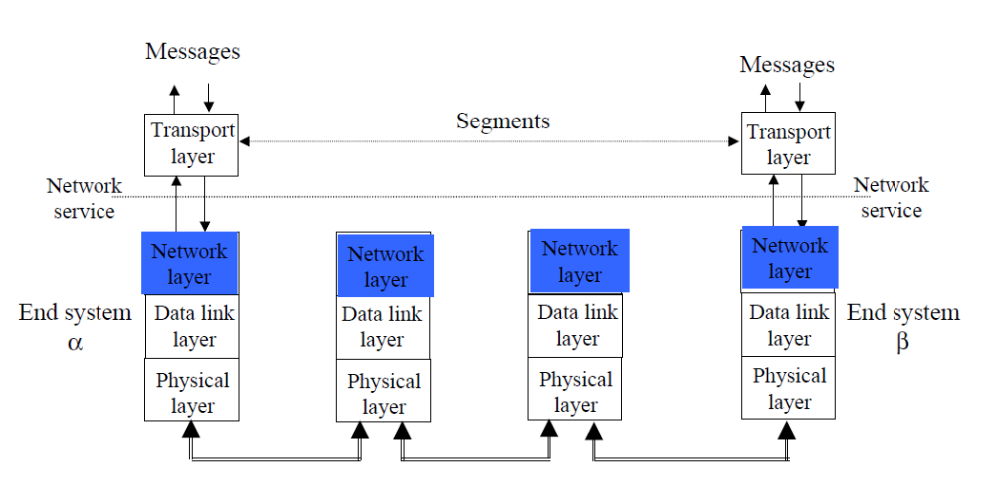

Slide 4
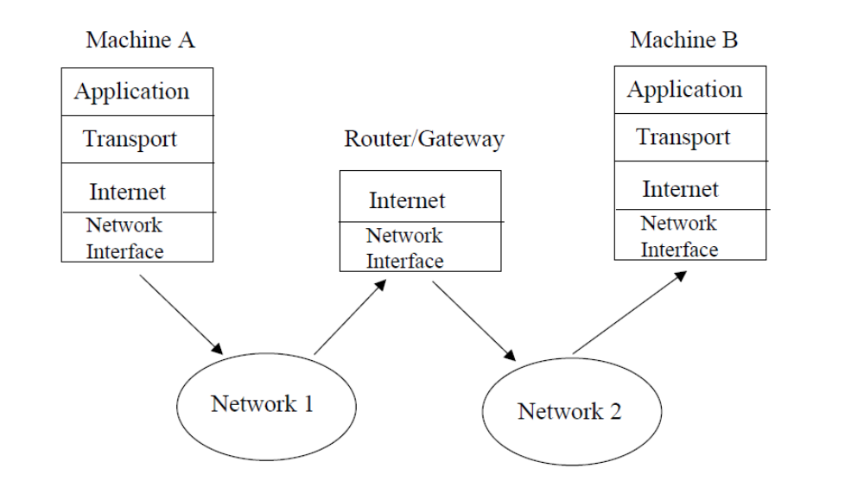

Slide 5
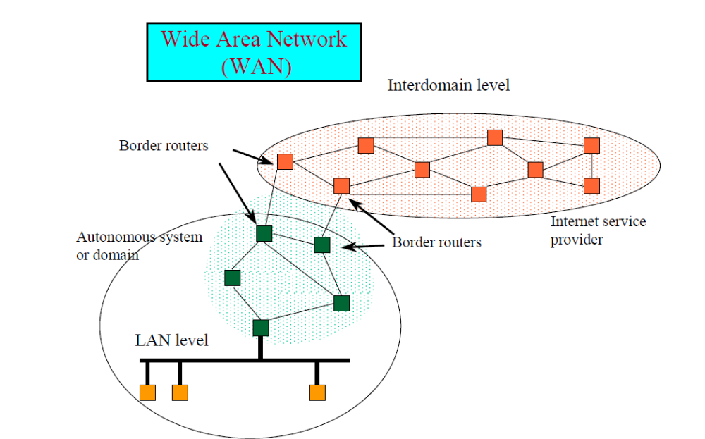


Slide 6
Functions of Network layer
Routing
  The process of transferring packets received from the Data Link Layer of the source network to the Data Link Layer of the correct destination network is called routing.
  Involves decision making at each intermediate node on where to send the packet next so that it eventually reaches its destination.
  The node which makes this choice is called a router. For routing we require some mode of addressing which is recognized by the Network Layer. This addressing is different from the MAC layer addressing.

Slide 7
Inter-networking
  The network layer is the same across all physical networks (such as Token-Ring and Ethernet).
  Thus, if two physically different networks have to communicate, the packets that arrive at the Data Link Layer of the node which connects these two physically different networks, would be stripped of their headers and passed to the Network Layer.
  The network layer would then pass this data to the Data Link Layer of the other physical network.

Slide 8
Congestion Control : If the incoming rate of the packets arriving at any router is more than the outgoing rate, then congestion is said to occur.
Congestion may be caused by many factors.
  If suddenly, packets begin arriving on many input lines and all need the same output line, then a queue will build up. If there is insufficient memory to hold all of them, packets will be lost.
  But even if routers have an infinite amount of memory, congestion gets worse, because by the time packets reach to the front of the queue, they have already timed out (repeatedly), and duplicates have been sent. All these packets are dutifully forwarded to the next router, increasing the load all the way to the destination.
  Another reason for congestion are slow processors. If the router's CPUs are slow at performing the bookkeeping tasks required of them, queues can build up, even though there is excess line capacity. Similarly, low-bandwidth lines can also cause congestion.

Slide 9
Network layer functions
transport packet from sending to receiving hosts
network layer protocols in every host, router
Three important functions:
path determination: route taken by packets from source to destination. Routing algorithms
switching: move packets from router’s input to appropriate router output
call setup: some network architectures require router call setup along path before data flows

Slide 10
Network Layer Design Issues
Services Provided to the Transport Layer
Store-and-Forward Packet Switching
Implementation of Connectionless Service
Implementation of Connection-Oriented Service
Comparison of Virtual-Circuit and Datagram Subnets

Slide 11
Services Provided to the Transport Layer
The network layer provides services to the transport layer at the network layer/transport layer interface.
The network layer services have been designed with the following goals in mind.
The services should be independent of the router technology.
The transport layer should be shielded from the number, type, and topology of the routers present.
The network addresses made available to the transport layer should use a uniform numbering plan, even across LANs and WANs.

Slide 12
Store-and-Forward Packet Switching
A host with a packet to send transmits it to the nearest router, either on its own LAN or over a point-to-point link to the carrier.
The packet is stored there until it has fully arrived so the checksum can be verified.
Then it is forwarded to the next router along the path until it reaches the destination host, where it is delivered.
This mechanism is store-and-forward packet switching

Slide 13
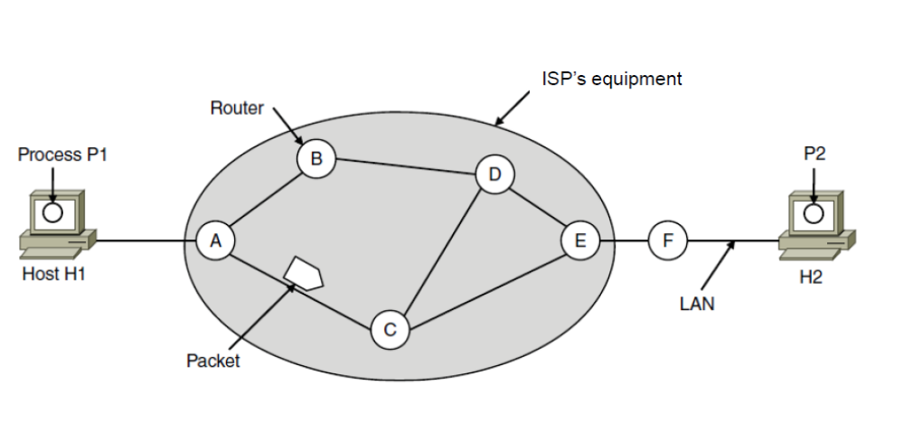

Slide 14
Packet Switching
Data is divided into small parts (packets)
Packets are transmitted from node to node, processed and forwarded
Also known as store‐and‐forward switching
Two connection types
Connectionless: datagram
Connection‐oriented: virtual circuit

Slide 15
Implementation of Connection-Oriented Service
If connection-oriented service is used, a path from the source router to the destination router must be established before any data packets can be sent.
This connection is called a VC (virtual circuit), in analogy with the physical circuits set up by the telephone system, and the subnet is called a virtual-circuit subnet.
When a connection is established, a route from the source machine to the destination machine is chosen as part of the connection setup and stored in tables inside the routers.
When the connection is released, the virtual circuit is also terminated.
With connection-oriented service, each packet carries an identifier telling which virtual circuit it belongs to.

Slide 16
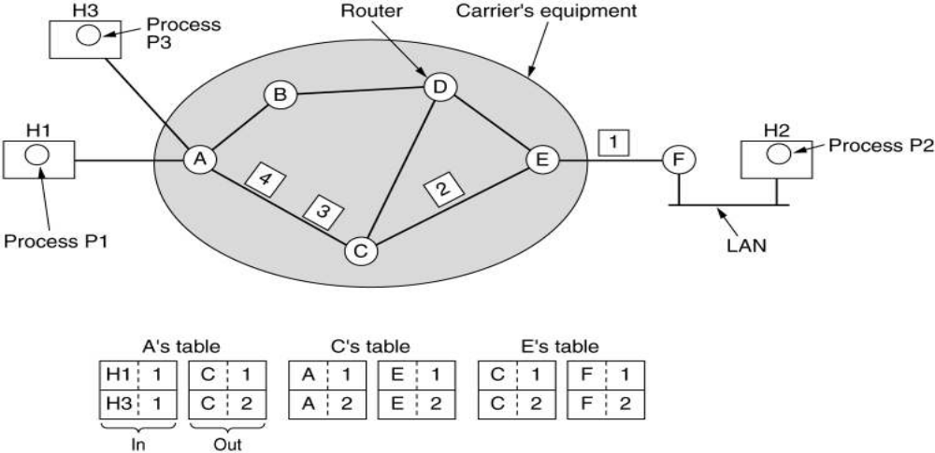
Routing within Virtual Circuit subnet

Slide 17
Implementation of Connectionless Service
No connection setup
Message is broken into packets
Each packet is individually routed
Routers decides line based on routing table
Packets may follow different paths
Not guaranteed to arrive in order
If connectionless service is offered, packets are injected into the subnet individually and routed independently of each other.
In this context, the packets are frequently called datagrams and the subnet is called a datagram subnet.

Slide 18
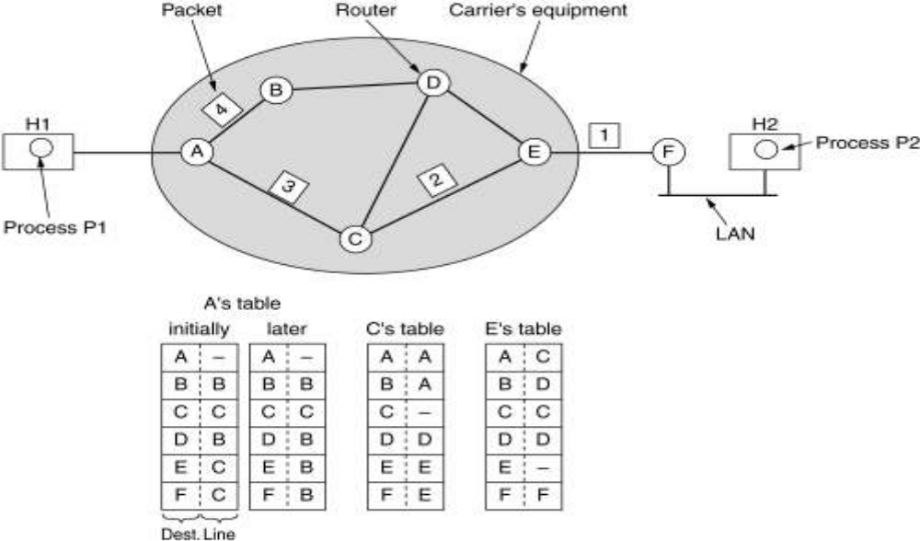
Routing within a datagram subnet

Slide 19
Routers
When a packet comes into a router, the frame header and trailer are stripped off and the packet located in the frame’s payload field is passed to the routing software. This software uses the packet header to choose an output line.
Each router has an internal table telling it where to send packets for each possible destination.
The algorithm that manages the tables and makes the routing decisions is called the routing algorithm.

Slide 20
Comparison of Virtual-Circuit and Datagram Subnets
One trade-off is between router memory space and bandwidth. VC allow packets to contain circuit numbers instead of full destination addresses.
If the packets tend to be fairly short, a full destination address in every packet may represent a significant amount of overhead and hence, wasted bandwidth.
Another trade-off is setup time versus address parsing time.
Using VC requires a setup phase, which takes time and consumes resources.
VC have some advantages in guaranteeing quality of service and avoiding congestion within the subnet because resources can be reserved in advance, when the connection is established.

Slide 21
